Slide 1

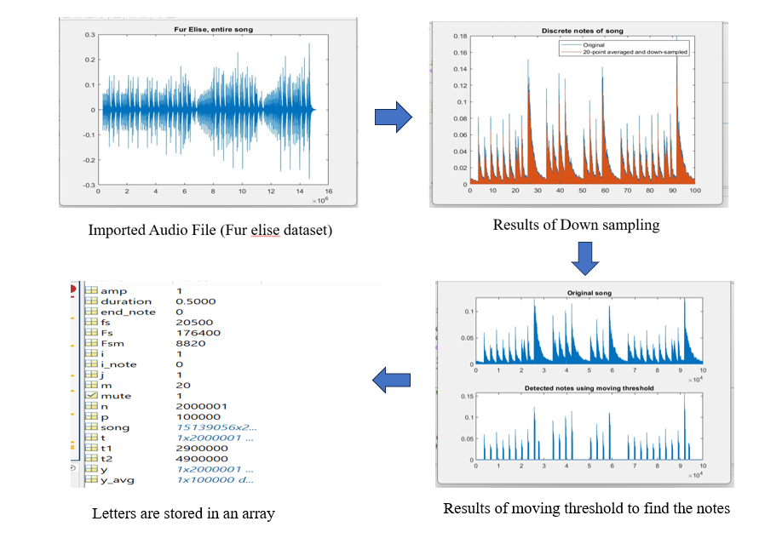
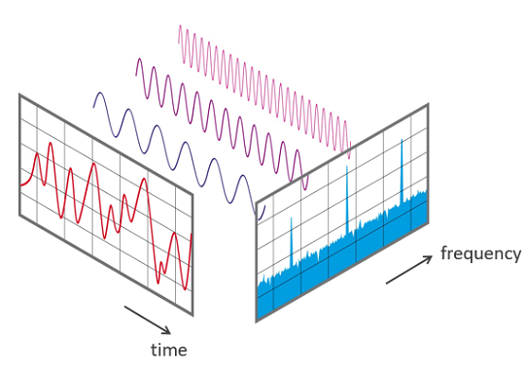

MATLAB Based Music Notes Extraction
Using Fast Fourier Transform
Team A9 : Praveen ; Komal; Chidambar ; Laxmi K
Guide : Prof . Sadanand Kulkarni
DEPT. OF ELECTRONICS & COMMUNICATION
Problem Statement :
DSP Techniques Used
Deeper understanding
To Develop a MATLAB algorithm that accurately extracts musical notes from an audio signal using the Fast Fourier Transform (FFT) technique.
.
Digital Audio Signals
FFT (Fast Fourier Transform)
Musical Notes Extraction
Fast Fourier Transform :
The Fast Fourier Transform (FFT) in Digital Signal Processing (DSP) is an algorithmic technique used to efficiently compute the Discrete Fourier Transform (DFT) of a sequence, typically a digital signal.
^{1. X(k) = ∑x(n)WNnk}
^{2. Yw[n] = w[n] ∗ x[n]}
View of Frequency domain and Time domain
Outcomes of PBL Approach
Deeper understanding
Improved problem-solving skills
Enhanced critical thinking skills
Deliverables
Algorithm for FFT
Methodology /Algorithm chosen.
Deepen understanding of signal processing concepts
Improve critical thinking and creativity
Music education and training
Music creation and performance
Objectives
Equations
Results
Block Diagram
Graphical Representation
Project Outcomes
Import Audio Signal
Preprocessing
Feature Extraction
Recognised Notes
Classification
Applications
Notes:
You can add your presentation notes here. This presentation template for research posters is fully editable so text, graphics and content can be updated to fit your own research needs.
Download more poster presentation templates from FPPT.com

